Slide 1

EXPLORATORY DATA ANALYSIS(EDA) PROJECT
E-COMMERCE FLIPKART-
MAJOR PHONE BRAND MARKET ANALYSIS
BY
VENU GOPAL BATHULA.

Slide 2
About me
I’m a B.Tech student passionate about Data Science and uncovering insights that solve real-world problems.
Skilled in Python, Pandas, NumPy, and visualization tools like Matplotlib and Seaborn, I focus on data cleaning, analysis, and visualization.
My goal is to turn data into meaningful, actionable solutions through my projects like Flipkart ecommerce data.

Slide 3

Project agenda
Data Collection (Web Scraping Process & Tools)
Project Overview & Objectives
Data Understanding & Preparation
Exploratory Data Analysis (EDA)
Data Cleaning & Preprocessing
Data Transformation & Manipulation
Univariate Insights
Bivariate Insights
Answering Key Business Questions
Findings & Insights
Challenges Faced & Key Learnings

Slide 4
BUSINESS PROBLEM OBJECTIVE
With the rapid growth of the smartphone market, customers are often overwhelmed by the wide range of models, features, and price variations available on e-commerce platforms like Flipkart.
Data on these platforms is usually unstructured and inconsistent, making it difficult to compare specifications such as RAM, battery capacity, camera quality, processor type, and overall value for money.
This project focuses on analyzing web-scraped Flipkart mobile data to understand market trends, customer preferences, and price-driving factors through Exploratory Data Analysis (EDA).

Slide 5
GOAL:
To extract, clean, and analyze smartphone data from Flipkart using Python-based EDA techniques and generate meaningful insights on:
How different specifications (RAM, camera, battery, processor, etc.) affect pricing.
Which brands receive higher ratings and reviews.
Identifying patterns and correlations between technical features and customer satisfaction.
Providing actionable insights for both buyers (to make better purchasing decisions) and brands (to align product strategies with market trends).

Slide 6
Objectives of the Project
To Scrape the real-world ecommerce data from Flipkart website.
To clean and preprocess the raw scraped data for accurate analysis.
To perform univariate, bivariate, and multivariate analysis for discovering hidden patterns.
To identify key factors affecting mobile prices and customer satisfaction.
To visualize relationships among important features using Seaborn and Matplotlib.
To draw business insights and actionable conclusions from the EDA visualization results.

Slide 7
Web scrapping process
Website: FLIPKART.COM
Tools used: Python ,BeautifulSoup , Requests , Pandas.
Steps Followed
Fetched multiple pages using Requests.
Parsed HTML content using Beautiful Soup.
Stored data in a Pandas Data Frame.
Exported the cleaned dataset to CSV format for further analysis.

Slide 8
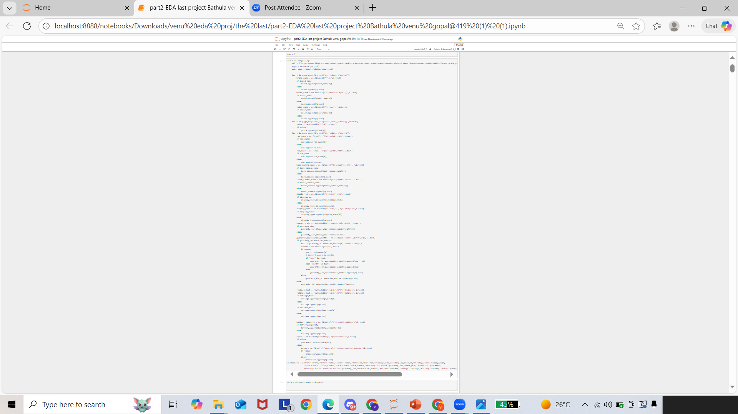
CODE PART

Slide 9
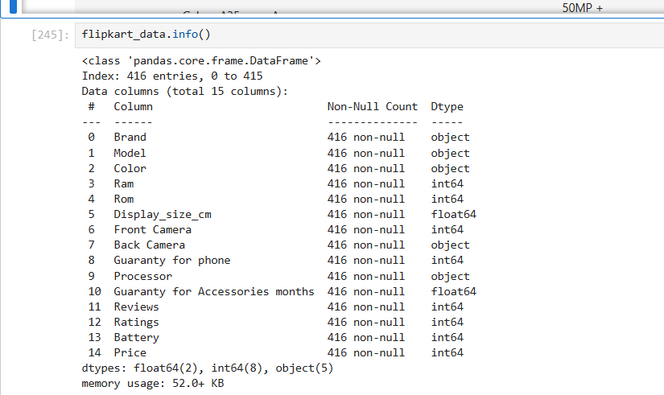
Summary of Collected Mobile Data
Total Records: 416
Columns: 15
Features included:
Model, Color, Ram, Rom, Price, Brand, Processor, Guaranty for phone, Guaranty for accessories for months, Reviews, Ratings, Display size cm, Frant camera, Back camera, Battery.
Insight:
The dataset contains detailed specifications ORRSV smartphone models listed on Flipkart.
It includes both technical attributes (RAM, battery, processor, camera) and user engagement metrics (ratings and reviews), providing a comprehensive view of factors influencing smartphone pricing and popularity.

Slide 10
DATA CLEANING :
Removed duplicate and irrelevant mobile entries.
Handled missing values in Brand, Processor, and Guaranty columns.
Cleaned and standardized Ratings and Reviews by removing commas and converting them to integers.
Converted Guaranty periods into months for uniform comparison.
Formatted numeric columns such as Price, Battery, RAM, and ROM to proper data types.
Trimmed unwanted characters and spaces in text columns like Processor, Model, and Color.
Pont to be noted: As they are numerous entries of brand my project focuses on specific brands(ORRSV) based on the popular brand usage.
ORRSV- Oppo, Redmi, Realme, Samsung, Vivo.

Slide 11
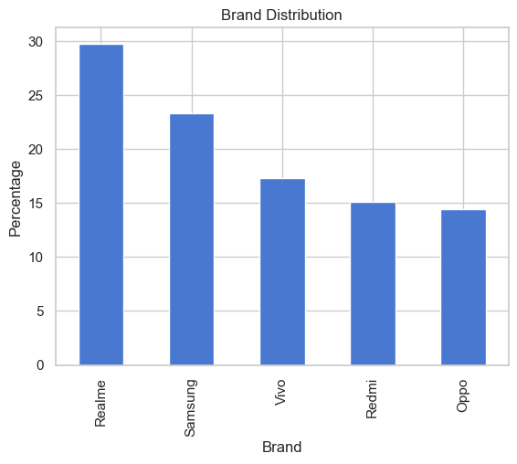
Univariate Analysis(Categorical):
Analysis – Brand Distribution
The chart shows that Realme dominates the market with nearly 30% share, followed by Samsung at around 23%.
Vivo, Redmi, and Oppo hold relatively smaller portions, ranging between 14%–17% each.
This indicates that Realme and Samsung are the most preferred brands among customers, possibly due to their strong performance-to-price ratio and market presence.

Slide 12
Bivariate Analysis
Plots Used:
Barplot, Scatter plot, Joint plot, Box plot, Violin plot, Displot.
Insights:
Price shows a moderate positive correlation with RAM and ROM, indicating higher memory configurations increase phone cost.
Battery capacity shows weak correlation with price — large batteries are available across all price ranges.
Ratings and Reviews are widely spread, showing customer engagement varies independently of price.
Scatterplots confirm that premium phones generally have larger displays and higher RAM/ROM.

Slide 13
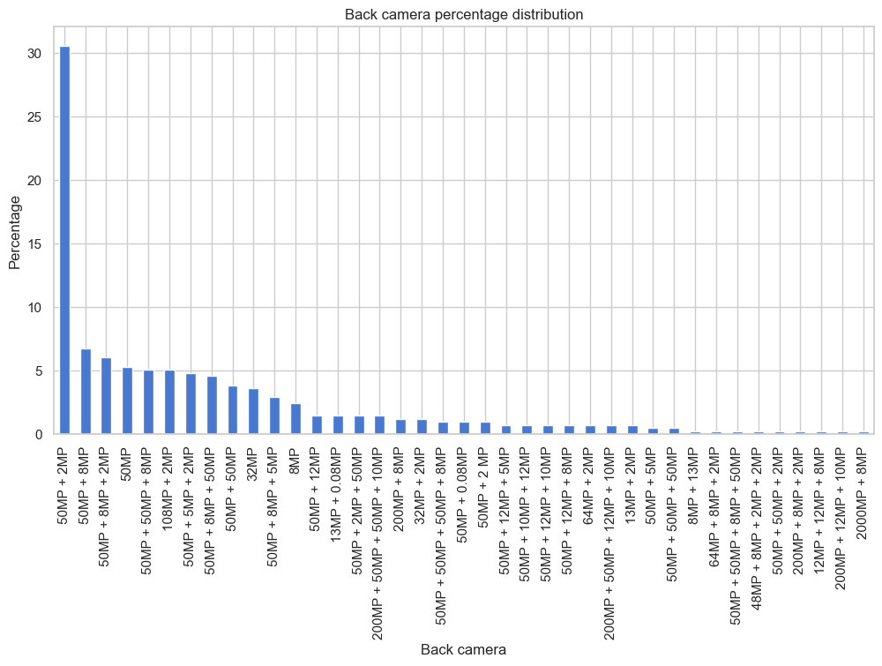
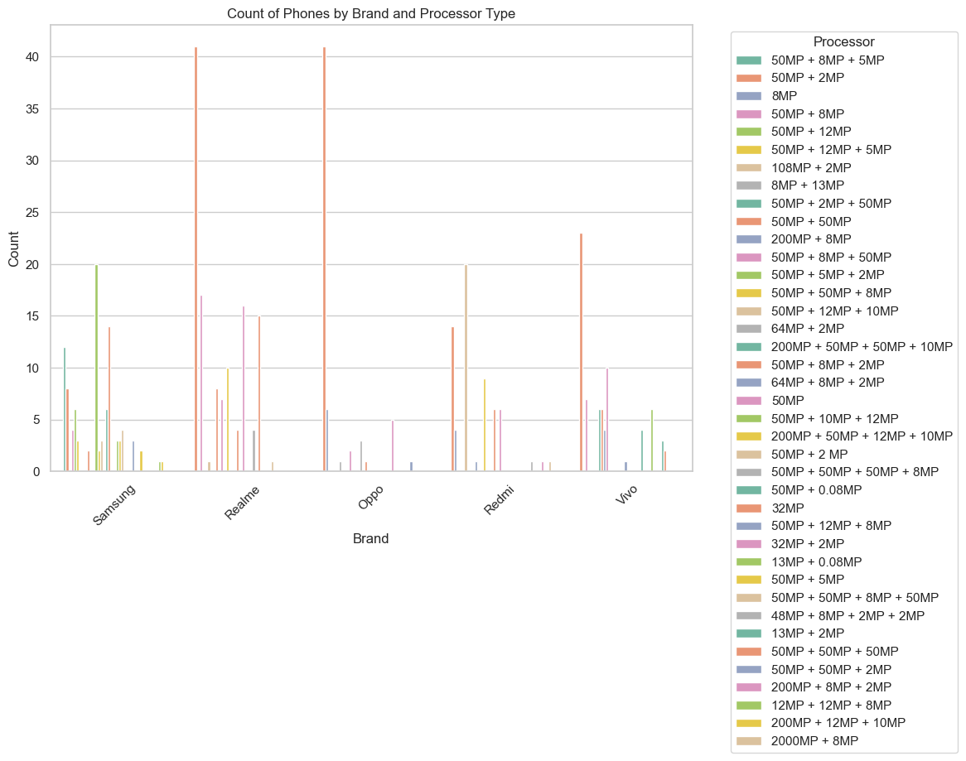
BACK CAMERA COMBINATION ANALYSIS:
The analysis shows that 50MP camera setups dominate across all major smartphone brands, especially combinations like 50MP + 2MP and 50MP + 8MP. Realme and Samsung lead in the number of models and variety of camera configurations, while Oppo, Redmi, and Vivo have fewer but focused options. Overall, brands are standardizing around 50MP sensors to balance performance, quality, and affordability.
Univariate Back Camera Percentage Distribution
Bivariate Brand vs. Back camera Type

Slide 14
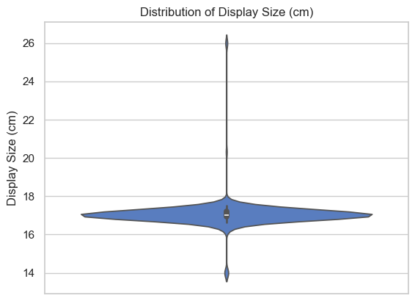
DISPLAY SIZE(cm) Analysis:
The violin plot illustrates the distribution of mobile phone display sizes in centimeters.
Most phones cluster around 17–18 cm, indicating that medium-sized displays dominate the market.
This concentration suggests that consumers prefer moderately large screens, balancing usability and portability.
A few models with much smaller or larger displays exist but are outliers, showing limited demand for extreme sizes.
The narrow spread around the central region reflects consistency in screen design trends across brands.
Overall, the analysis indicates that manufacturers tend to focus on producing phones within this optimal display range to cater to the majority of user preferences.

Slide 15
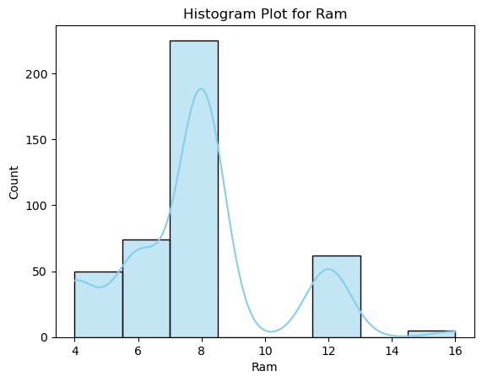
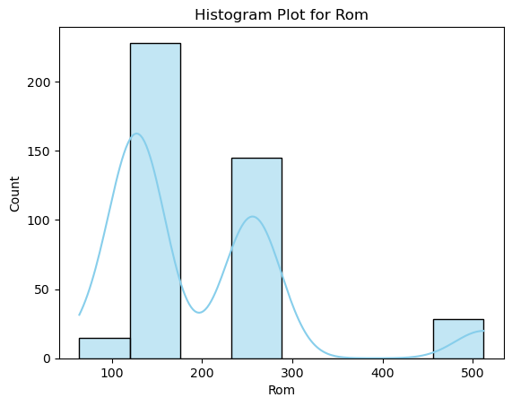
RAM AND ROM ANALYSIS:
Most smartphones in the dataset feature 8 GB RAM and 128 GB ROM, indicating that mid-range devices dominate the market. Higher configurations like 12 GB RAM or 256–512 GB ROM appear less frequently, showing limited presence of premium models.
Histogram plot Ram
Histogram plot for Rom

Slide 16
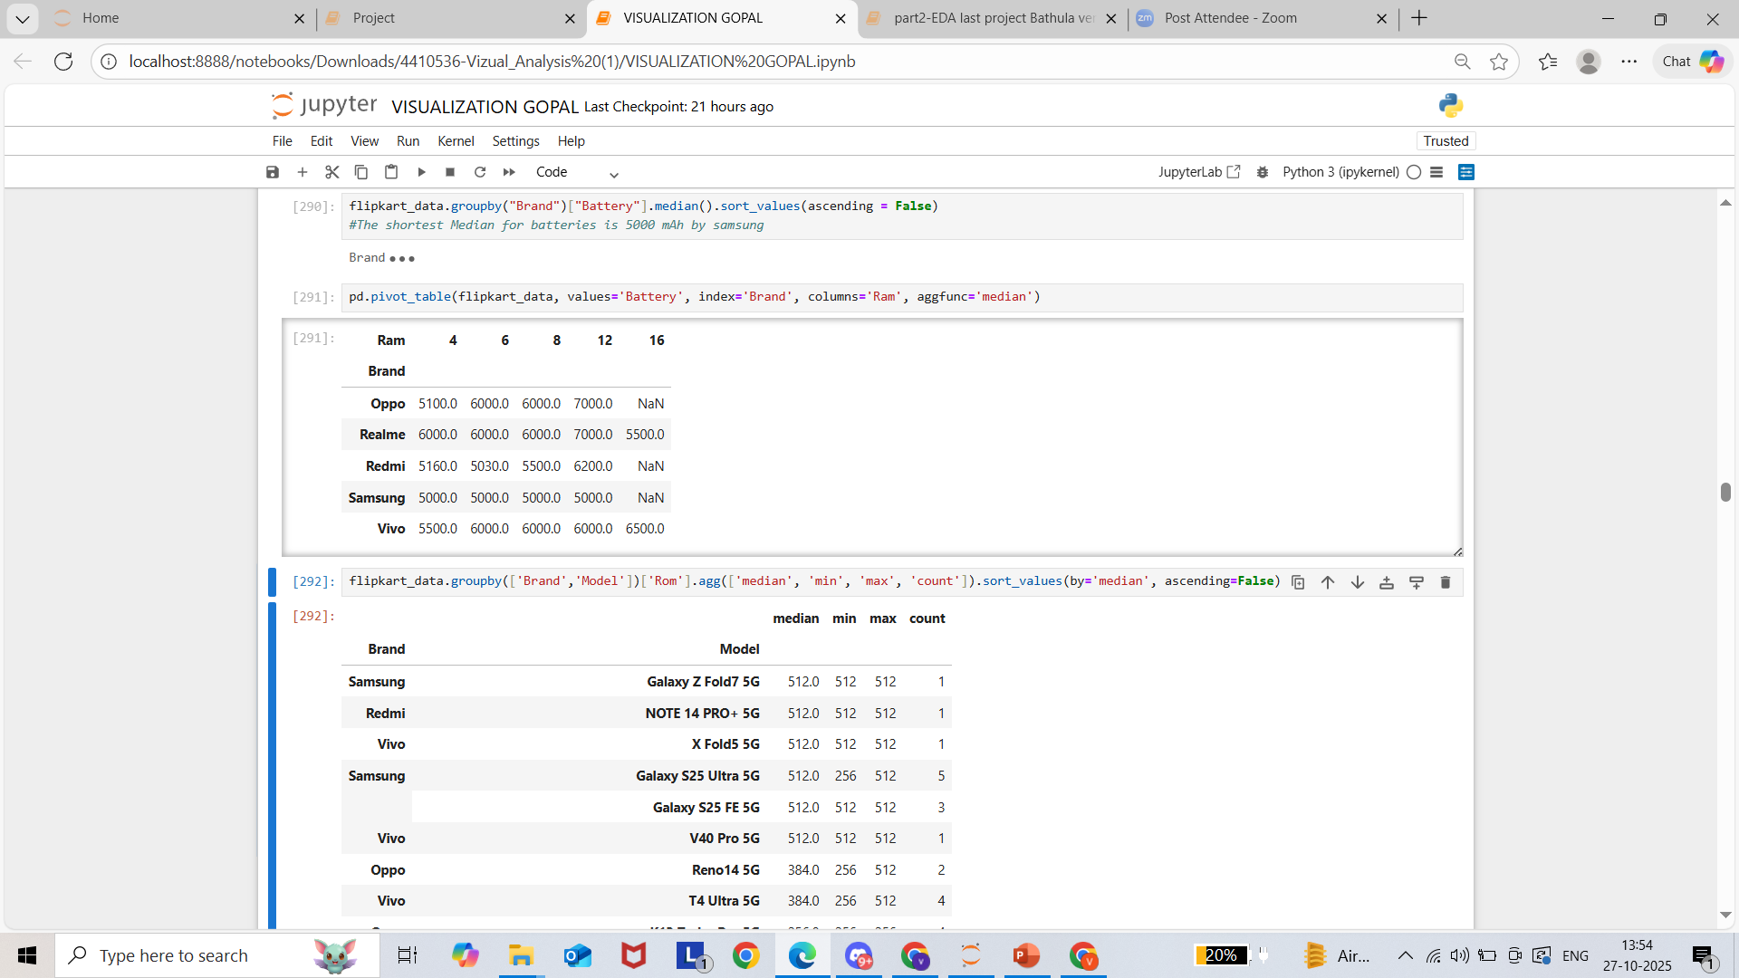
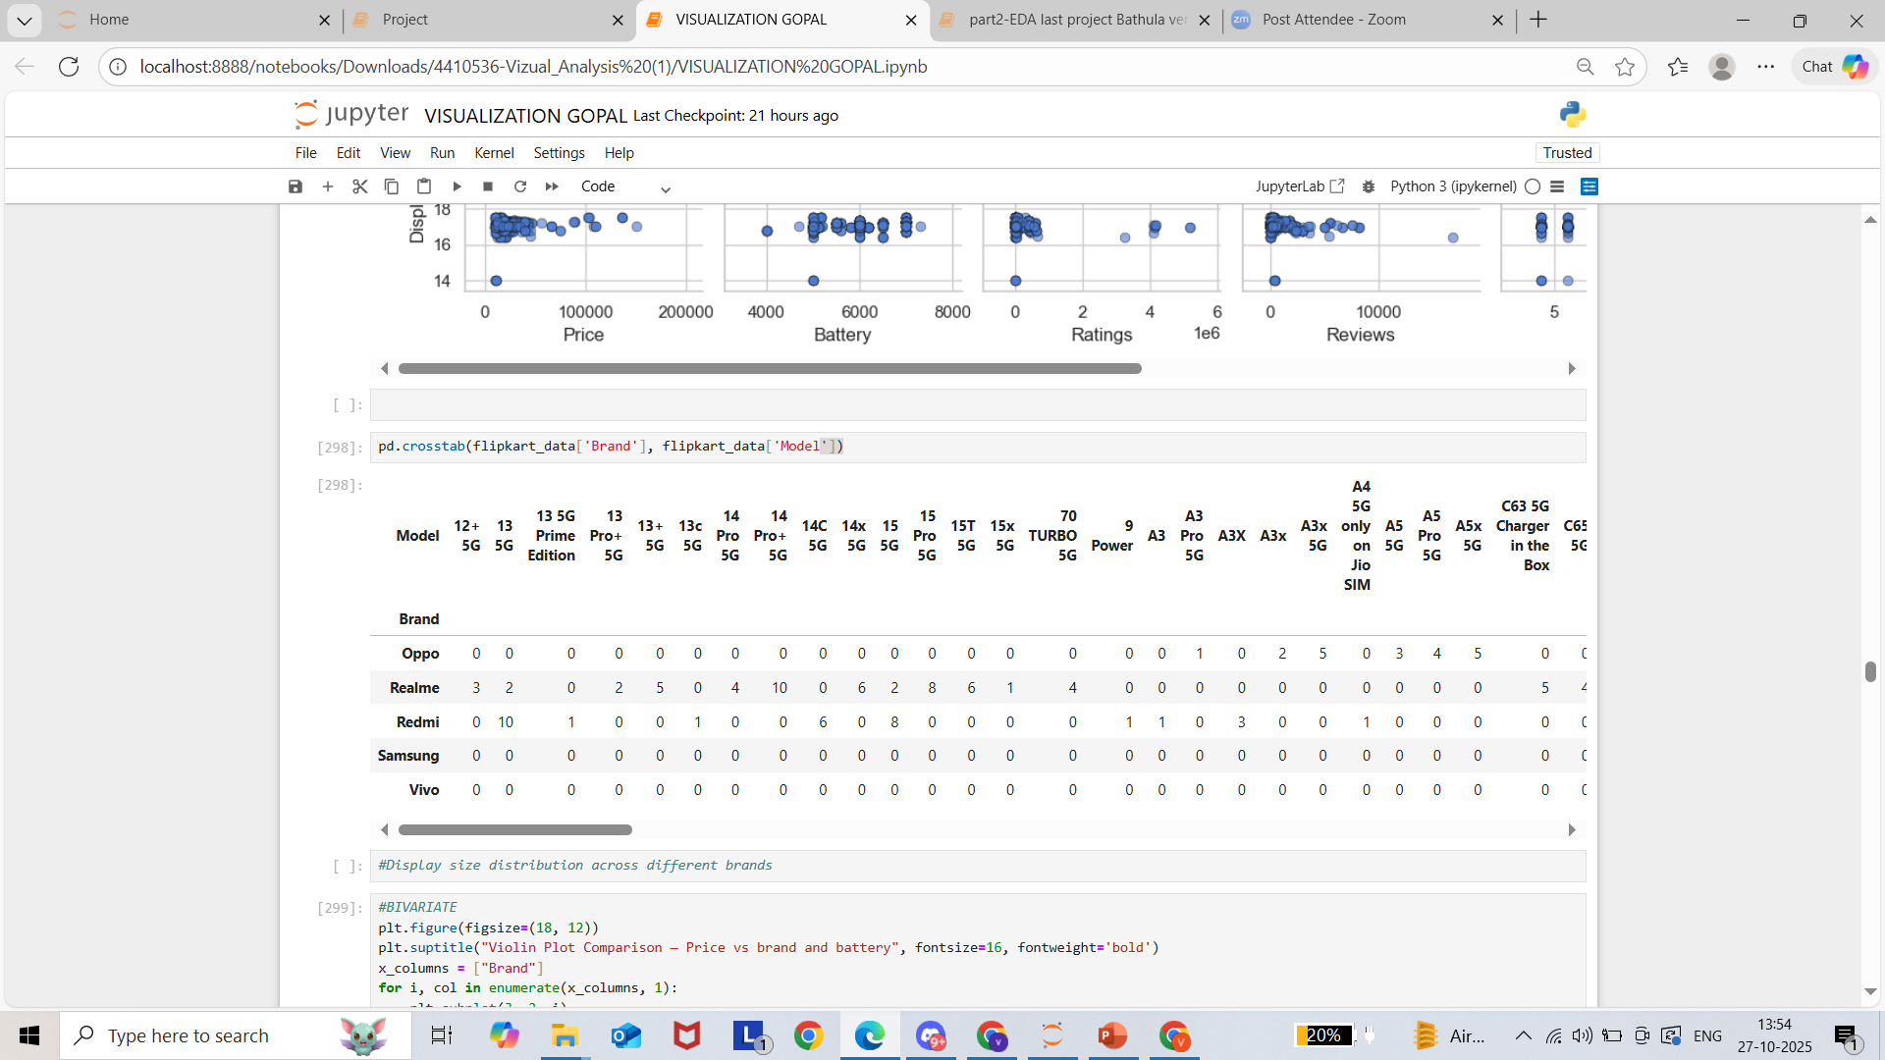
Pivot tables help analyze relationships, such as average price by ROM,PRICE or RAM size, allowing us to see which features lead to higher prices.
Crosstabs are useful for examining frequency distributions, like how many phones fall into each RAM–ROM or Brand–Model combination.
Pivot Table
Crosstab

Slide 17
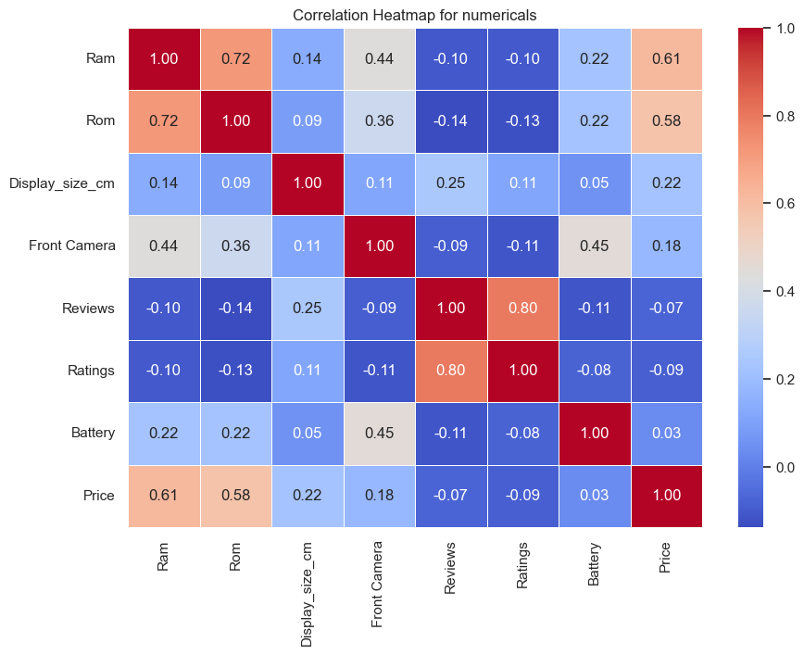
Analysis of Heat map Based on Core Components
The correlation heatmap reveals the relationships between numerical features of mobile phones.
RAM and ROM show a strong positive correlation (0.72), indicating that phones with higher RAM often come with larger storage capacities.
Price is moderately correlated with RAM (0.61) and ROM (0.58), suggesting that memory capacity significantly impacts cost.
Ratings and reviews are highly correlated (0.80), implying that higher-rated phones tend to receive more reviews.
The front camera shows moderate correlation with battery (0.45), reflecting design consistency in mid-range to high-end devices.
Overall, performance-related features like RAM and ROM most strongly influence price and customer satisfaction.

Slide 18
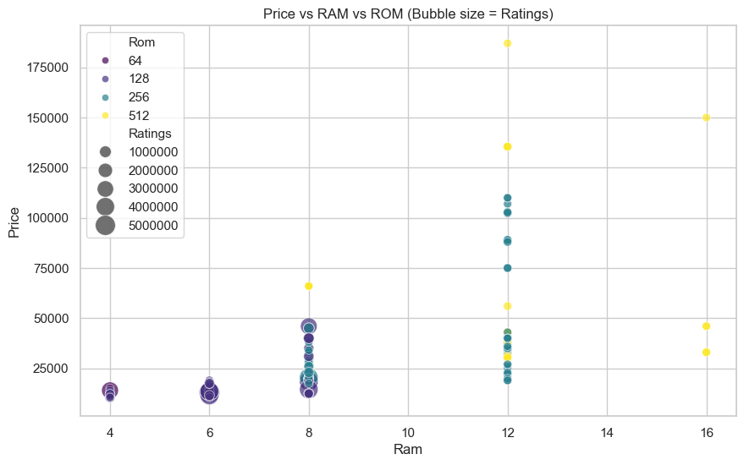
Ram and Rom Analysis Based on Price
This bubble plot visualizes the relationship between RAM, ROM, and Price, with bubble sizes representing Ratings.
It clearly shows that smartphones with higher RAM (12GB–16GB) and ROM (256GB–512GB) tend to have significantly higher prices. Models with moderate configurations (6GB–8GB RAM, 128GB ROM) are the most common and receive more customer ratings, suggesting higher popularity and sales.
Devices with high memory configurations are positioned in the premium segment, appealing to performance-focused users.
Overall, this visualization highlights how storage and memory capacity directly influence smartphone pricing, while user ratings emphasize demand trends for mid-range configurations.

Slide 19
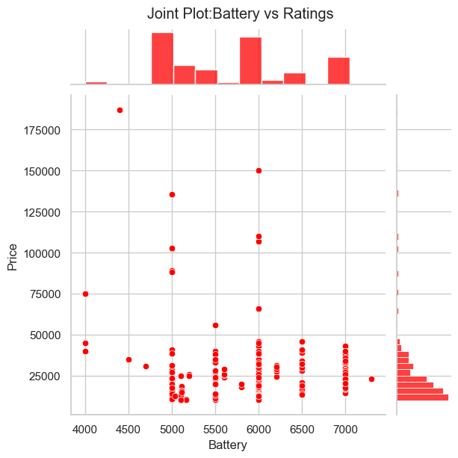
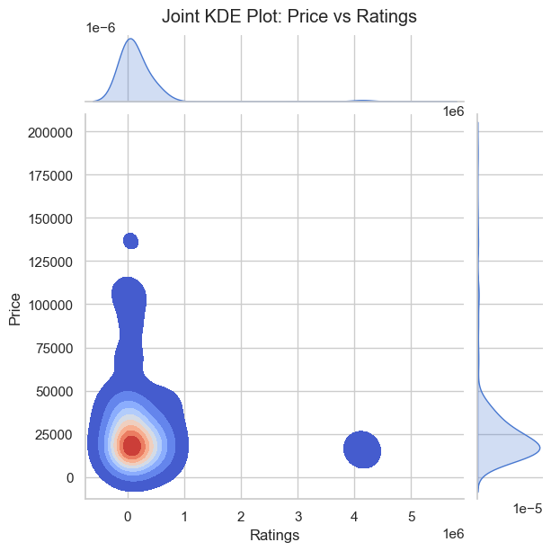
Ratings Analysis :
Battery capacity and price show minimal correlation, indicating that higher battery power doesn’t always mean higher cost. Similarly, the KDE plot shows ratings mostly concentrated in lower price ranges, suggesting affordability often drives higher user engagement rather than premium pricing.
Joint plot: Battery vs Ratings
Joint plot: Price vs Ratings

Slide 20
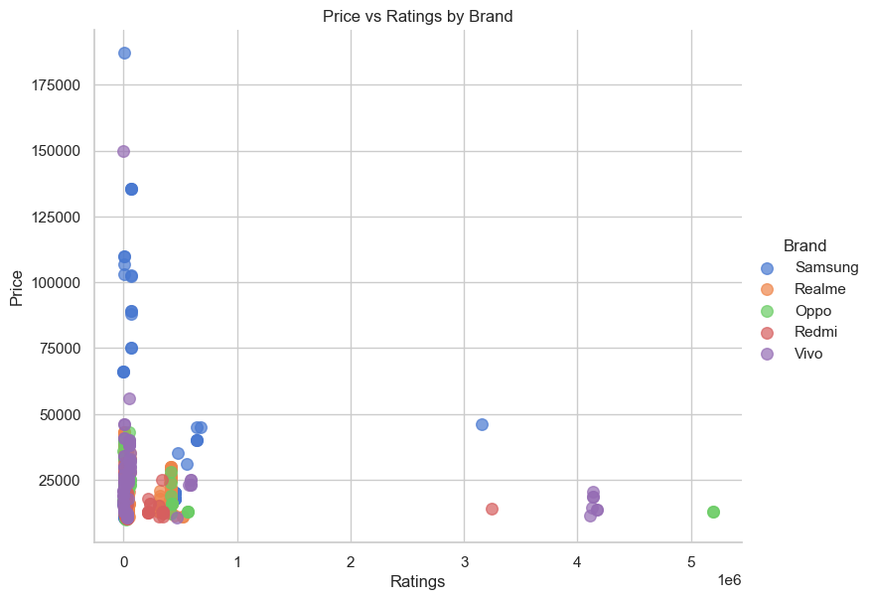
Price Analysis based on Ratings Across brands
Insights
  High Ratings Are Not Price-Dependent:Even low-priced phones (especially from Redmi and Realme) have high ratings, showing that value and performance matter more than price
  Brand Positioning:Samsung spans all price tiers but faces competition from Redmi and Realme in the mid-range due to similar or better ratings at lower prices.
  Budget and Mid-Range Phones Dominate:Most brands have a strong presence below ₹40,000, reflecting consumer preference for affordable models.
  User Satisfaction:Redmi and Realme consistently achieve higher ratings, suggesting strong consumer trust in budget-friendly performance.
Conclusion:
  The scatter plot shows that Redmi and Realme dominate the mid-range smartphone segment, earning high ratings despite lower prices.
  Samsung covers all price categories, including premium models, but its ratings are similar to those of mid-range competitors, indicating that higher cost doesn’t guarantee better user satisfaction.
  Oppo and Vivo also perform well in the mid-tier market with steady ratings. Overall, the data suggests that affordable smartphones deliver comparable quality and satisfaction to high-end models, highlighting a strong consumer preference for value-driven brands like Redmi and Realme in the Indian smartphone market.

Slide 21
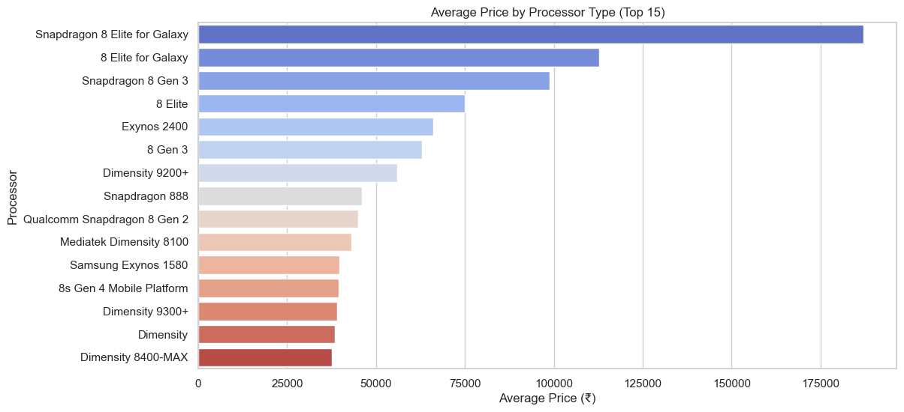
Processor Analysis Based on price
This bar plot illustrates the average smartphone price by processor type, revealing that premium processors like Snapdragon 8 Elite for Galaxy and Snapdragon 8 Gen 3 command the highest prices, exceeding ₹1,00,000.
These processors are typically found in flagship models, emphasizing top-tier performance and efficiency.
Exynos 2400 and Dimensity 9200+ also belong to the upper mid-range segment, balancing cost and performance.
Meanwhile, processors such as Dimensity 8100, Exynos 1580, and Dimensity 8400-MAX are associated with more affordable devices.
Overall, this visualization highlights how processor type significantly influences smartphone pricing, reflecting its role in performance, power efficiency, and market positioning.

Slide 22
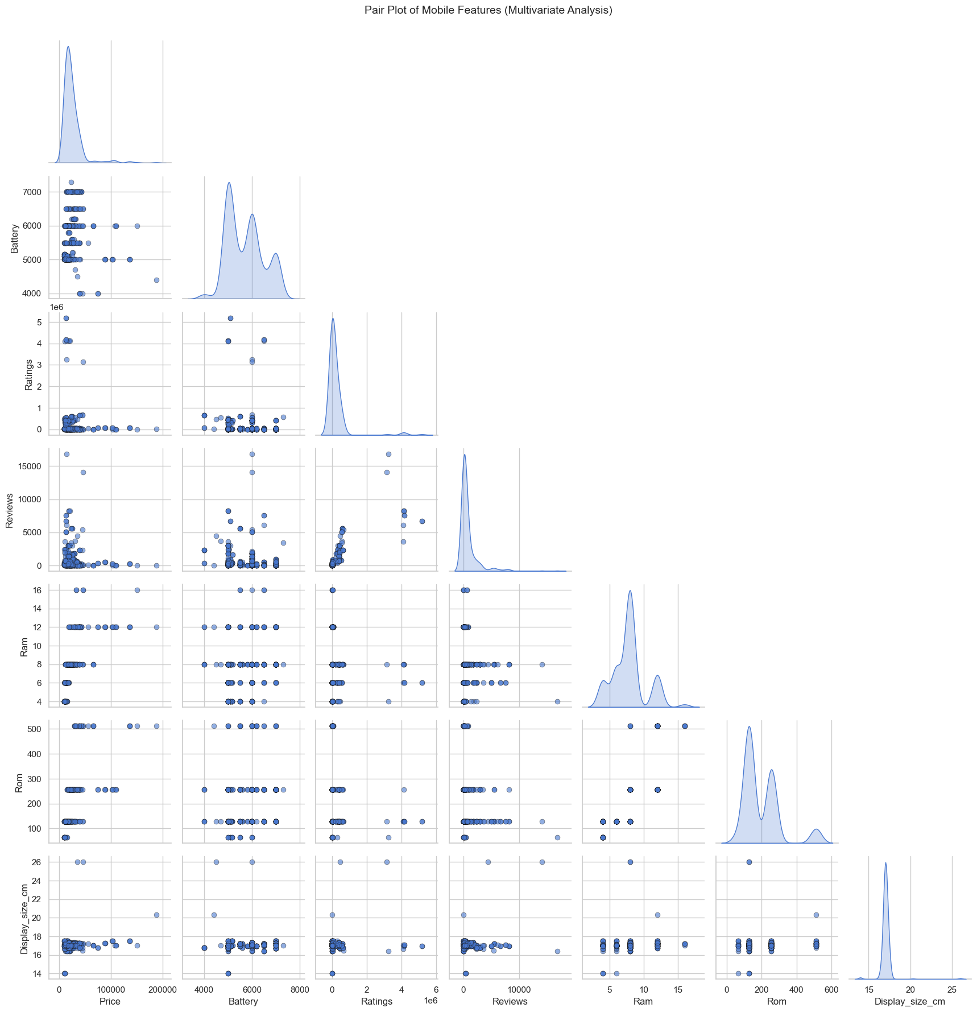
Pair plot Analysis for different Indicators
This pair plot provides a multivariate analysis of key smartphone features such as Price, Battery, Ratings, Reviews, RAM, ROM, and Display Size.
From the visualization:
  Price shows a weak positive relationship with RAM and ROM, suggesting higher-priced phones tend to have better memory configurations.
  Battery capacity does not show a strong correlation with price, indicating that even mid-range phones often offer large batteries.
  Ratings and Reviews are widely scattered, meaning customer feedback varies across all price ranges.
  Display size slightly increases with price and RAM, showing that premium devices generally feature larger displays.
Overall, the pair plot highlights moderate relationships among technical specifications and price, while user-driven metrics like ratings remain independent.

Slide 23
Challenges & Learnings
Challenges Faced:
  Collecting consistent mobile specifications from multiple product pages.
  Extracting and cleaning text with symbols and commas in numeric fields.
  Handling missing or duplicate values in product listings.
  Converting and formatting prices, ratings, and reviews for analysis.
Learnings:
  Improved knowledge of web scraping, data preprocessing, and visualization using Python.
  Gained strong understanding of EDA techniques to find patterns and insights.
  Enhanced ability to handle real-world messy data effectively.

Slide 24
Conclusion
  Mid-range smartphones are the most popular on Flipkart.
  Price increases with higher RAM, ROM, and advanced processor types.
  Snapdragon 8 series and Exynos 2400 dominate the premium segment.
  Battery capacity and display size moderately impact the overall price.
Overall Insight:
  Flipkart’s smartphone market shows a clear pattern — as performance specifications like RAM, ROM, and processor quality improve, the prices rise significantly. High-end phones attract more attention, while mid-range models remain the top-selling category.

Slide 25

Thank You & Regards,
Venu Gopal Bathula.

